Slide 1

Visualization On Ramen Data
Tableau Viz link

Slide 2
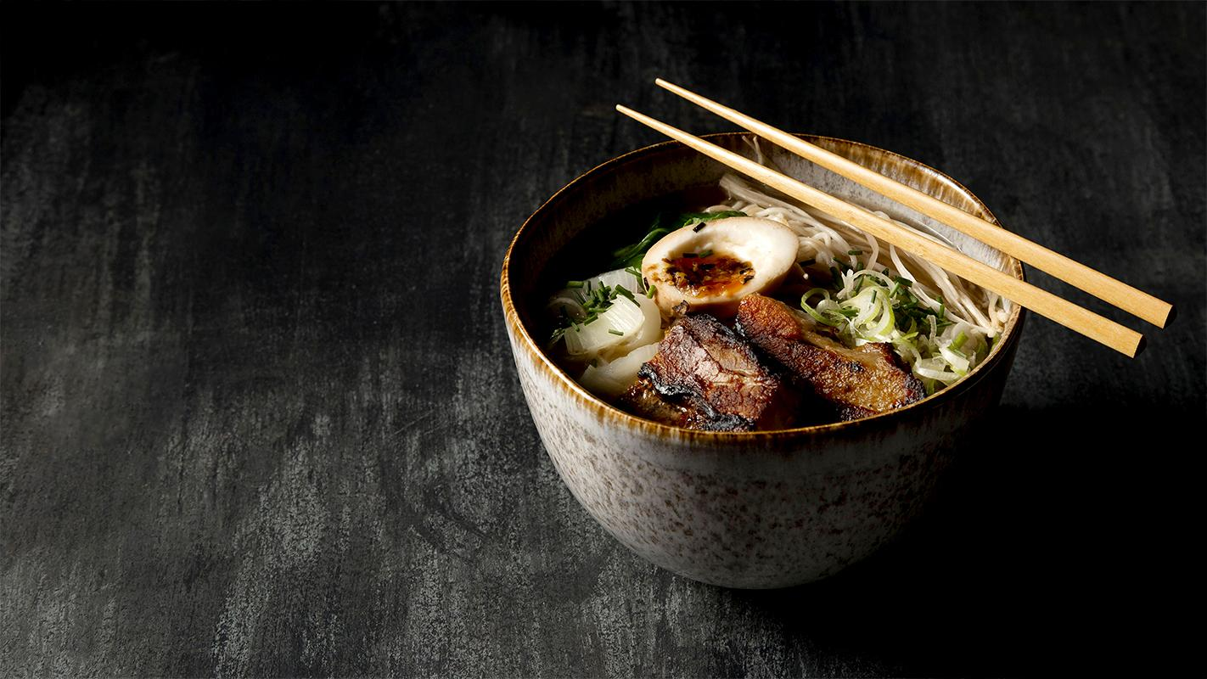
Why Ramen?
(Instant Noodles)

Slide 3
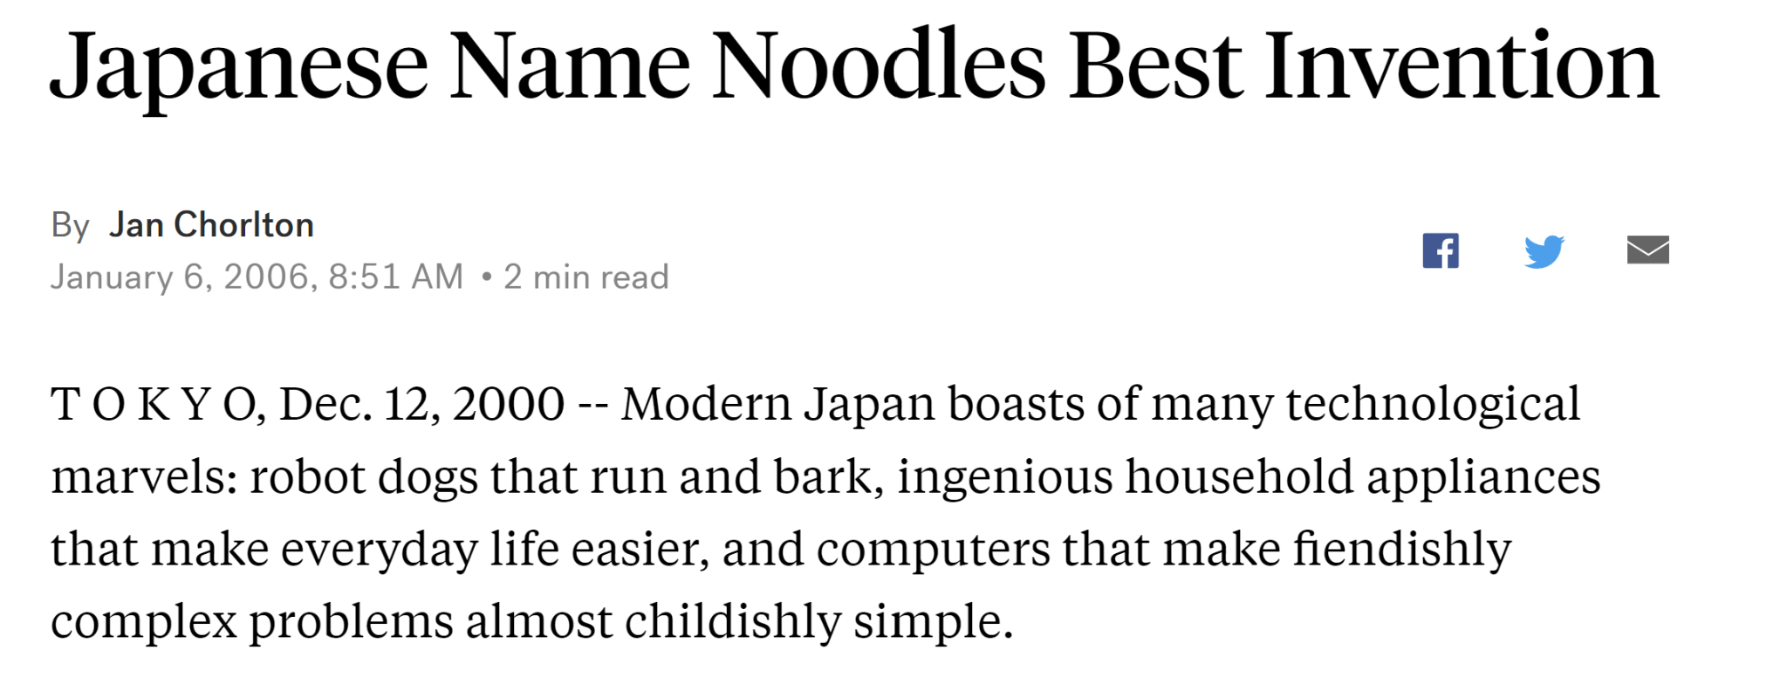
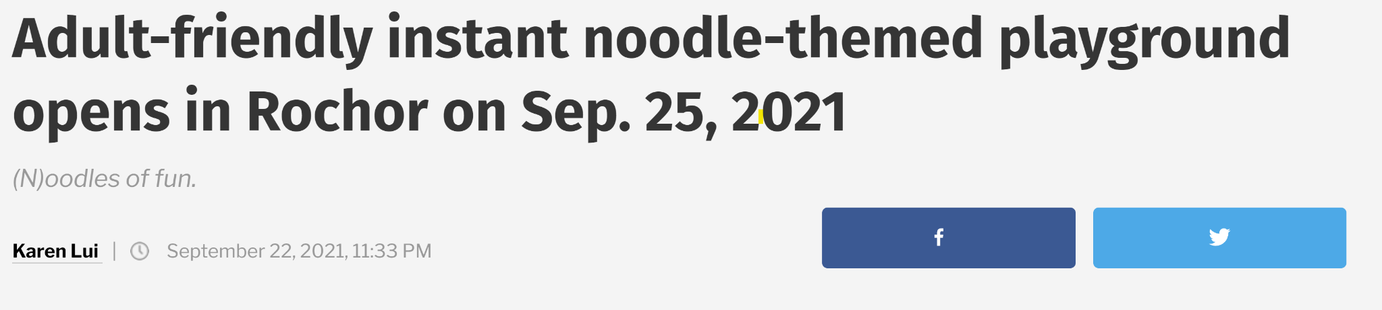
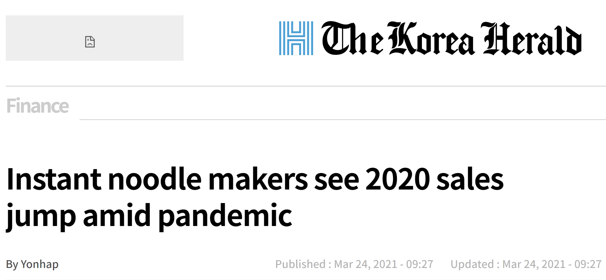
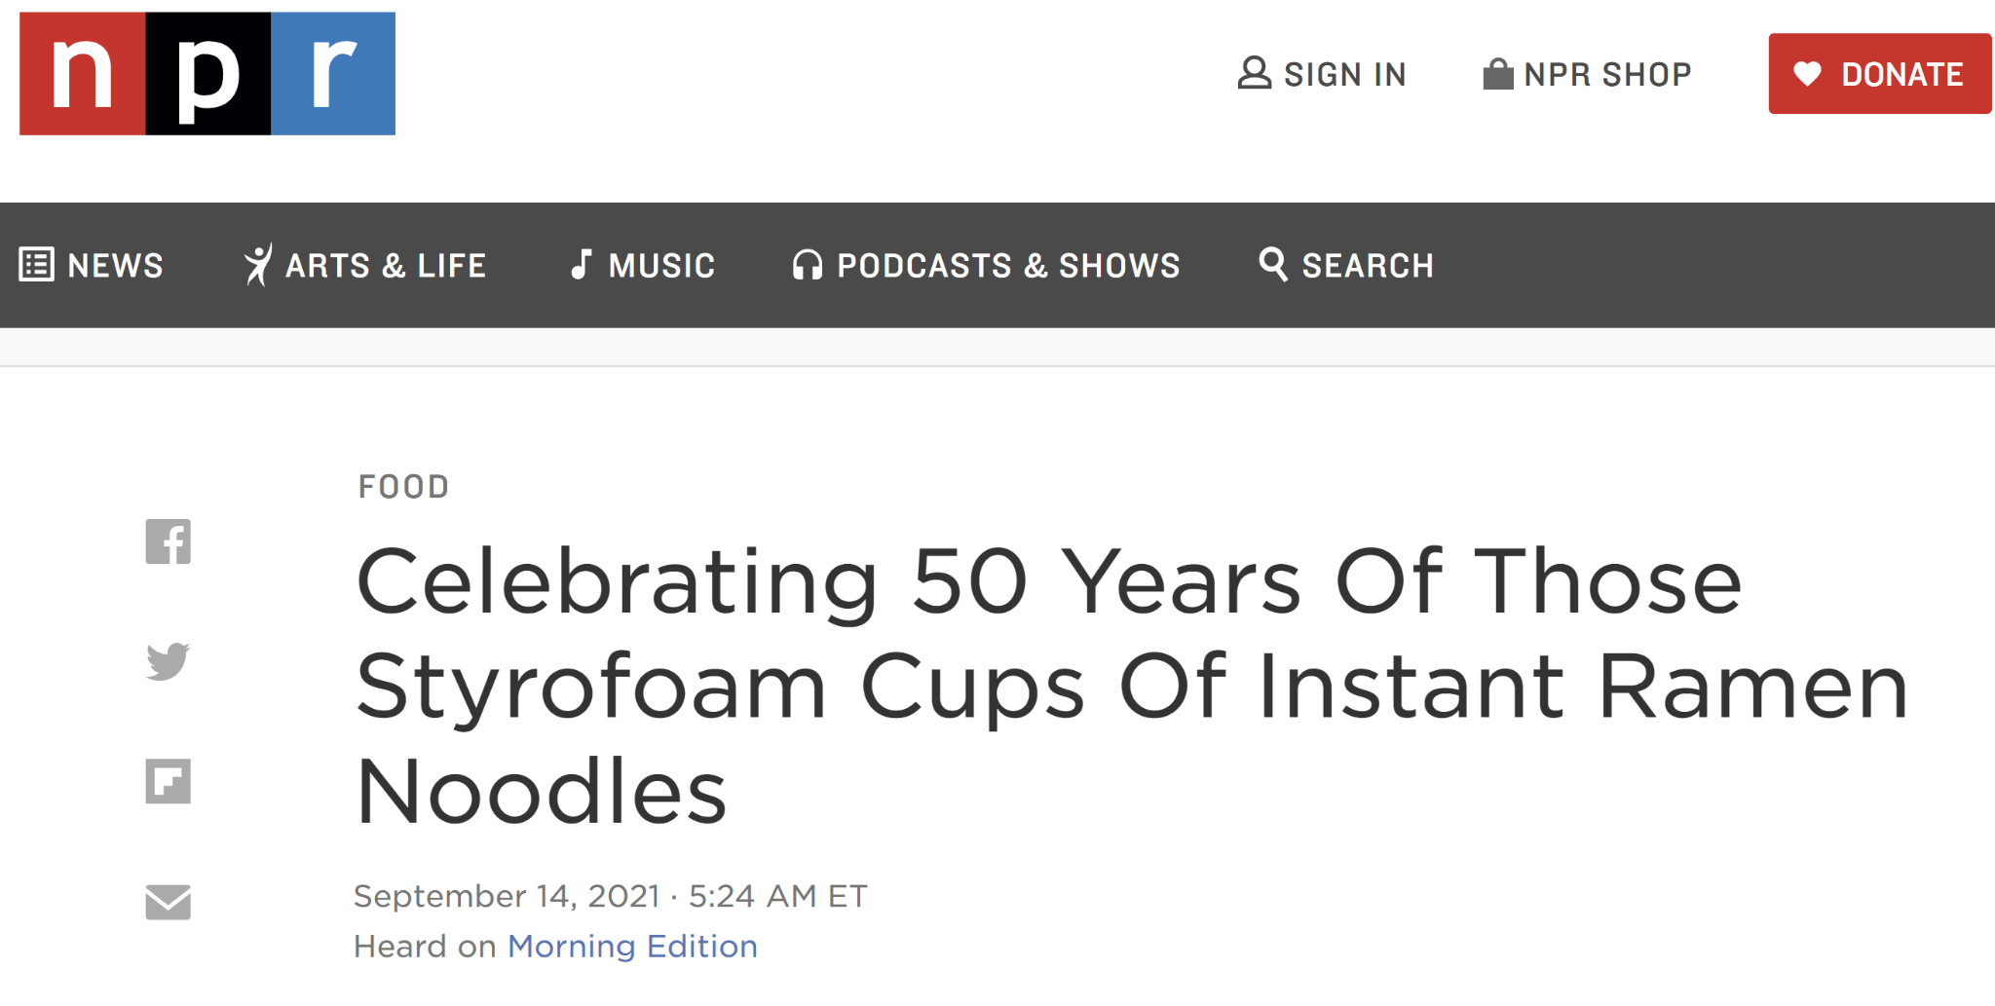
In-home Ramen is a worldwide phenomenon

Slide 4
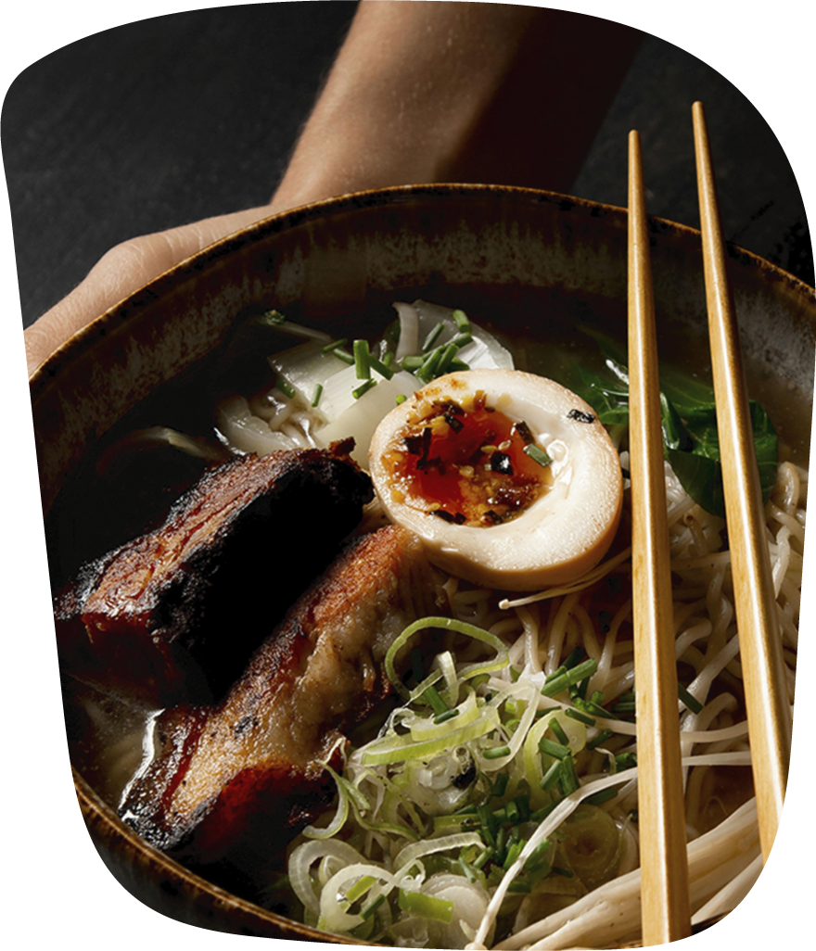
How Is Ramen Consumed Worldwide?

Slide 5



Data Source
At WINA, companies and organizations around the world related to instant noodles unite to undertake initiatives for improving quality so that consumers all over the world can eat instant noodles tastily and with peace of mind.
World Instant Noodles Association
https://www.theramenrater.com/
The Ramen Rater
The Ramen Rater is a product review website for the hardcore ramen enthusiast (or "ramenphile"), with over 2500 reviews to date. This dataset is an export of "The Big List" (of reviews),.
https://instantnoodles.org/en/
The World Bank Open Data
The World Bank is an international financial institution that provides loans and grants to the governments of low- and middle-income countries for the purpose of pursuing capital projects.
https://www.worldbank.org/en/home

Slide 6

Challenges
Missing Data
Top 10 rated list: Incomplete / Not up to date
Rating Source
No criteria/guidelines on how ratings were given

Slide 7

Visualization Topics
01
02
03
Global Demand
Preferences
Top Lovers
How is Ramen demand worldwide?
What are the trends of Ramen?
Which countries are true Ramen enthusiasts?

Slide 8

01
Global Demand
Total &
Individual Consumption

Slide 9
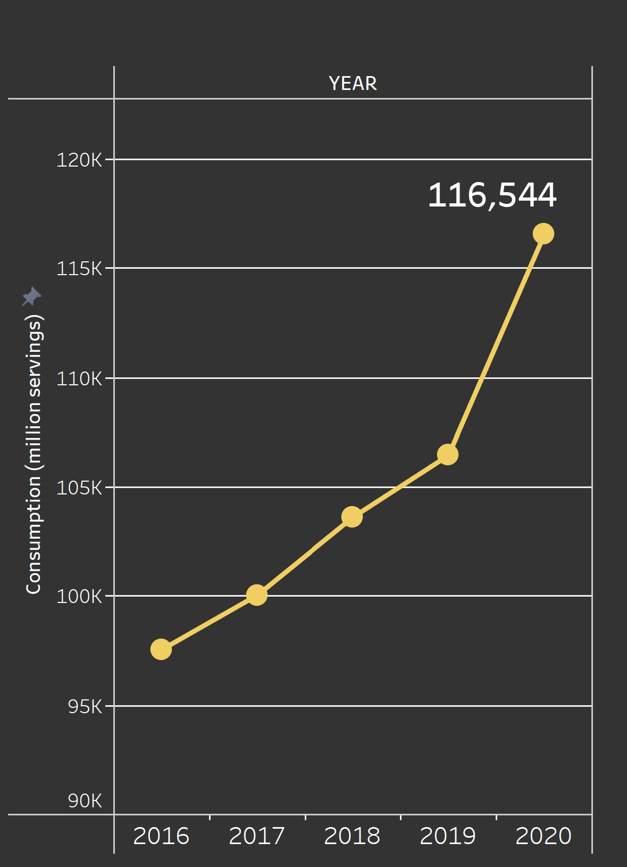
Cravings are strong for Ramen
116 Billion Servings
In 2020
2017 | 2018 | 2019 | 2020
+3% | +4% | +3% | +9%

Slide 10
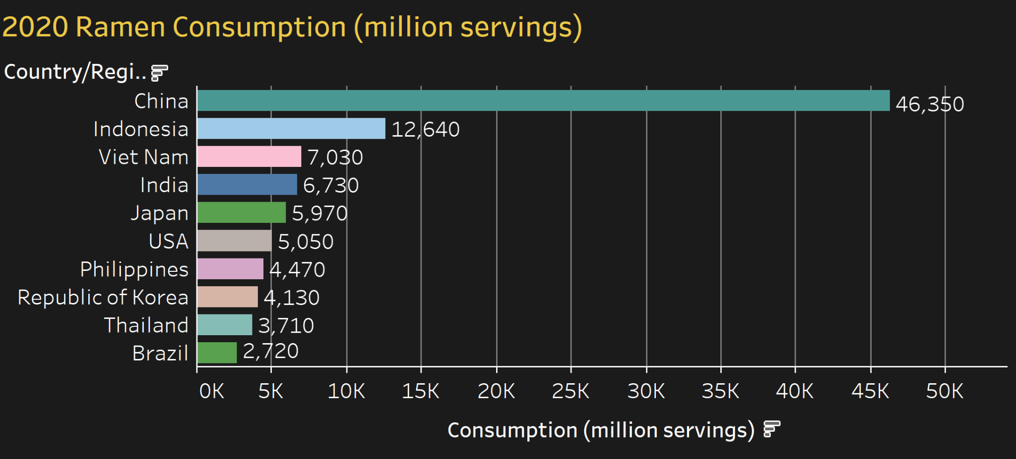
Top 10 Ramen Consuming Countries

Slide 11
These 10 countries contributed
85%
of global Ramen consumption

Slide 12
But Who Loves Ramen the Most?
Which country consumes most Ramen individually?

Slide 13
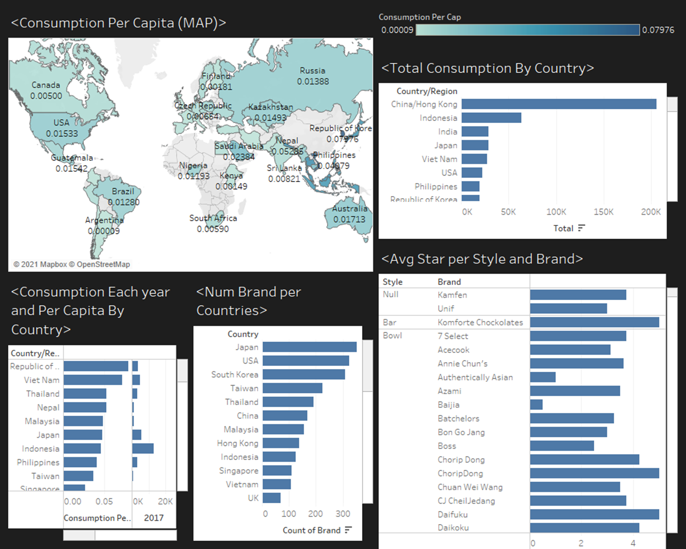
Consumption per capita
https://public.tableau.com/app/profile/bokun.chen/viz/RamanConsumptionGlobal/Dashboard1?publish=yes

Slide 14
Ramen Ranking
https://public.tableau.com/app/profile/bokun.chen/viz/Vizfinalproject/Dashboard1?publish=yes

Slide 15
02
Preferences
Ramen preferences in details

Slide 16
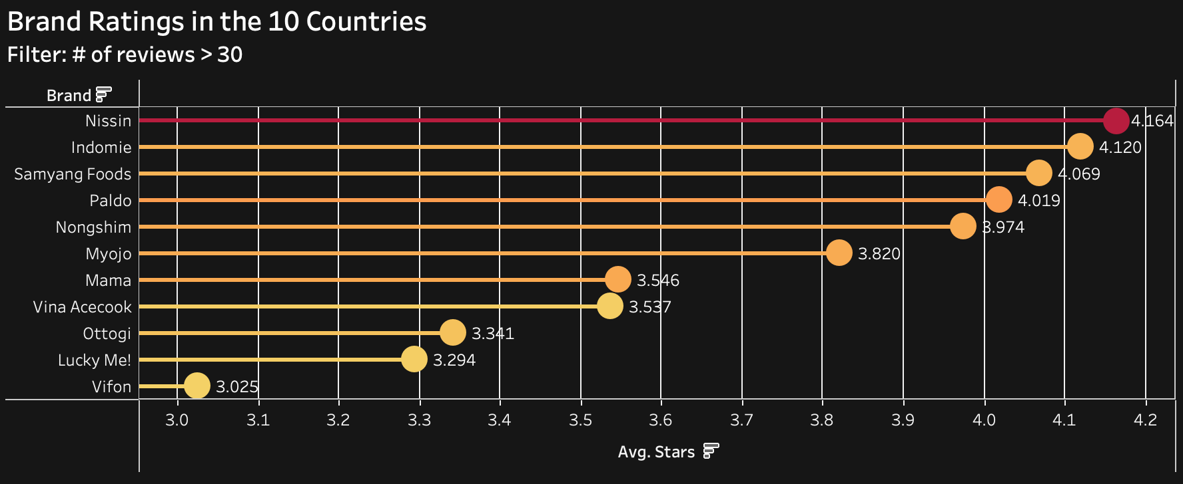
Popular Ramen Brands
Nissin received the highest rating and the most reviews

Slide 17
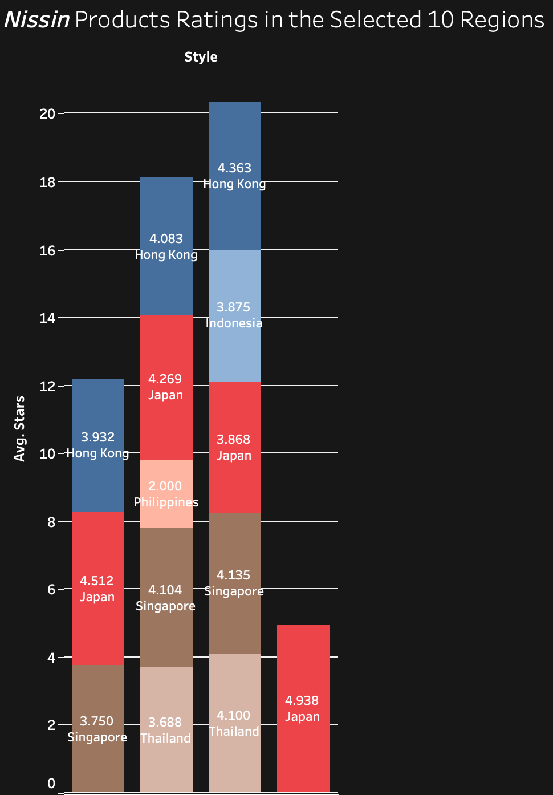
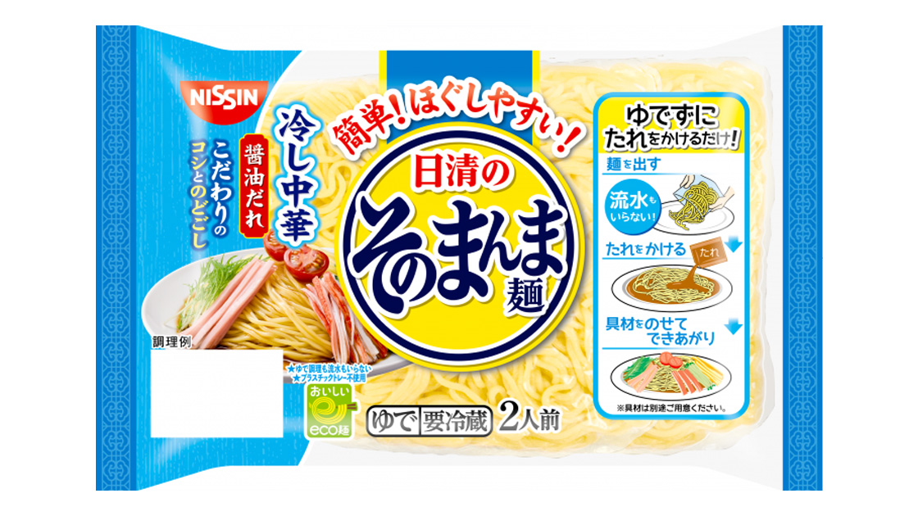
Nissin’s Products
Tray ramen had the highest rating but only available in Japan
Bowl
Cup
Pack
Tray

Slide 18
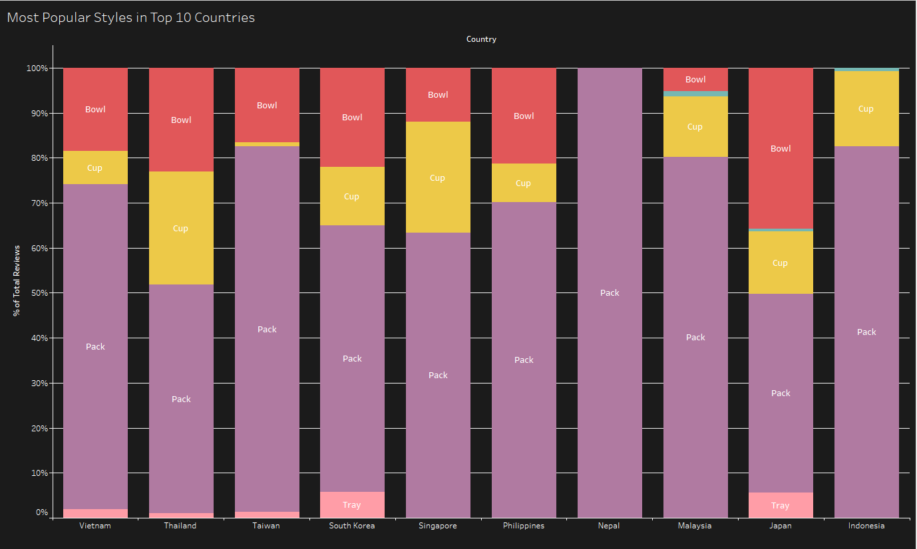
The most popular ramen styles
Pack is the most popular style in all countries because of the lower price

Slide 19
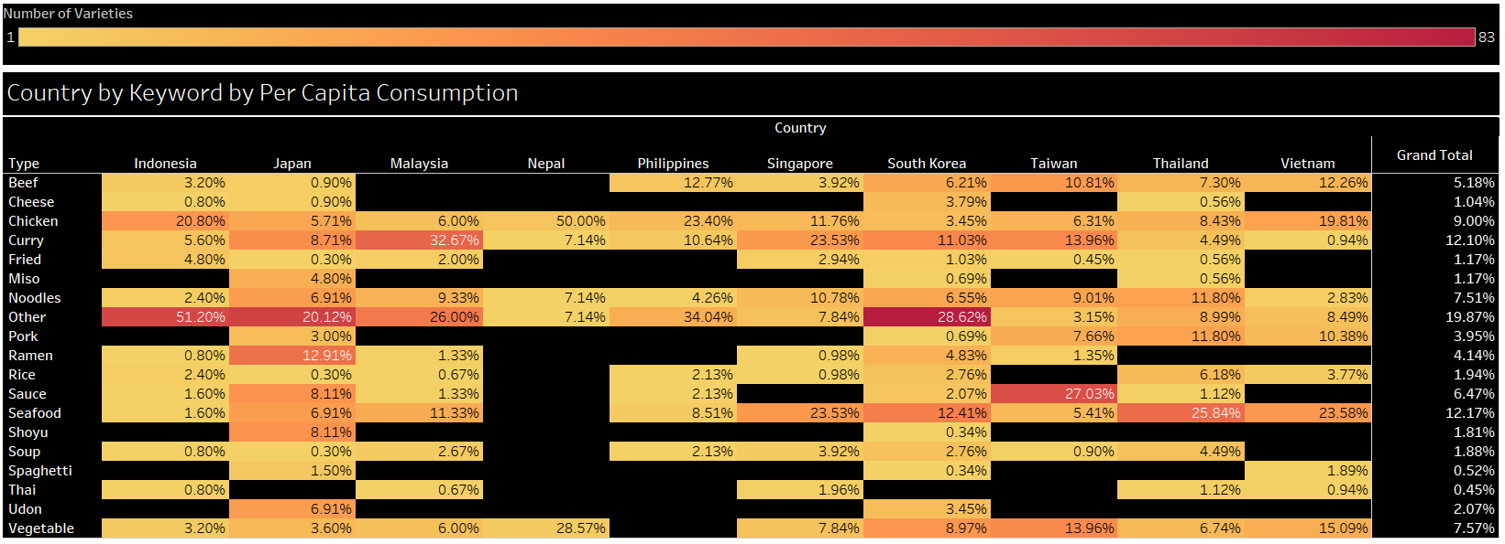
Country by Keyword
Top 10 by per Capita Consumption
Notes:
South Korea has cheese based flavors
Words like Miso - Ramen - shoyu - Udon are more common in Japan.
Indonesia has more fried instant noodles.
Taiwan has more sauce based noodles.
Pork based instant noodles are produced more in Taiwan and Thailand.
South Korea and Taiwan both have more vegetable based instant noodles.

Slide 20
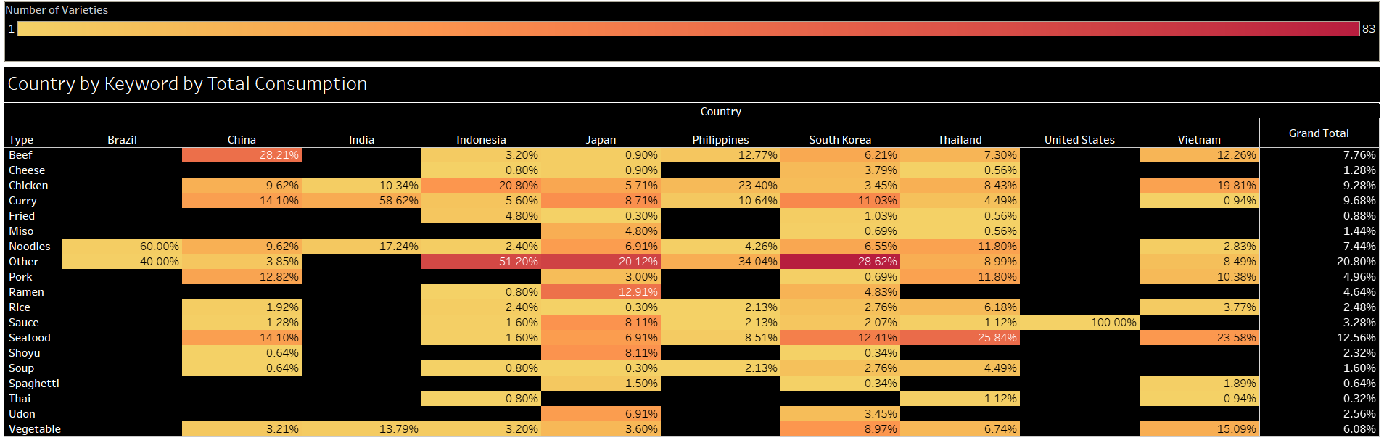
Country by Keyword
Top 10 by Total Consumption

Slide 21
03
The Top 10
Top 10 ramen demanding countries
&
Top 10 ramen in the world

Slide 22
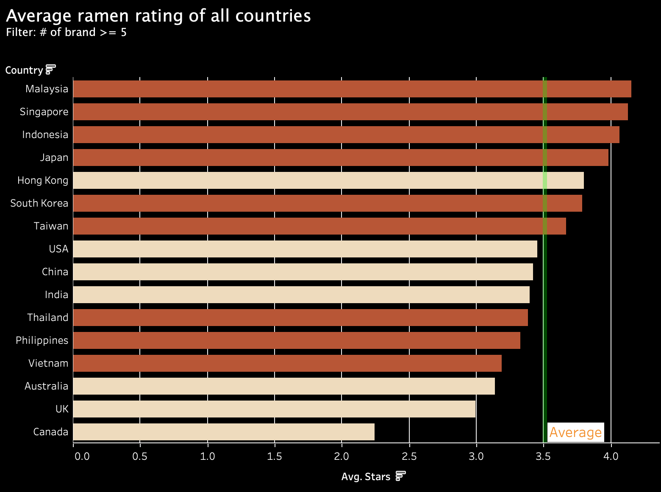
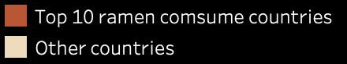
Average ramen rating of all countries
Top 4 are all from top 10 ramen consume countries
Notes:
This plot shows the avg ramen rating of all countries with a filter that the country has more than 4 ramen brands to avoid bias. Top 10 ramen consuming countries are marked in dark brown.
As we can see, the Top 4 countries in average ramen rating, Malaysia, Singapore, Indonesia and Japan are all from the top 10 ramen consuming countries. And their ratings far exceed the average rating which is marked as the green vertical line in the plot. South Korea and Taiwan, ranked 6th and 7th, their ratings are above the average score as well.
While Thailand, Philippines and Vietnam's ramen ratings are lower than the average rating. All three are Southeast Asian countries. Even if their ramen demand ranks in the top ten, people in other regions may not particularly accept the flavors of their district. This may be the reason that their ratings are lower than average.

Slide 23
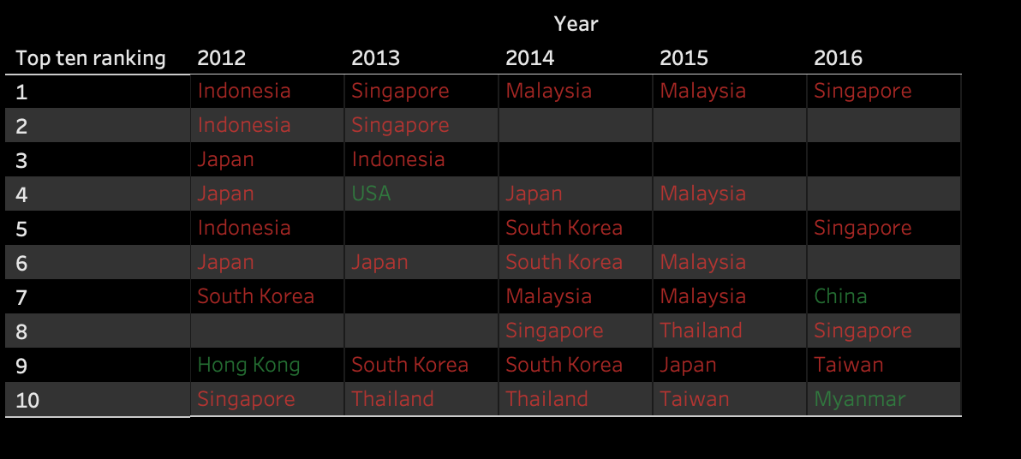
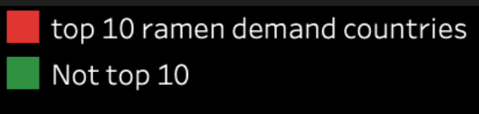
Ramen demand & Ramen making
Most top 10 ramen demand countries made to top 10 ramen

Slide 24
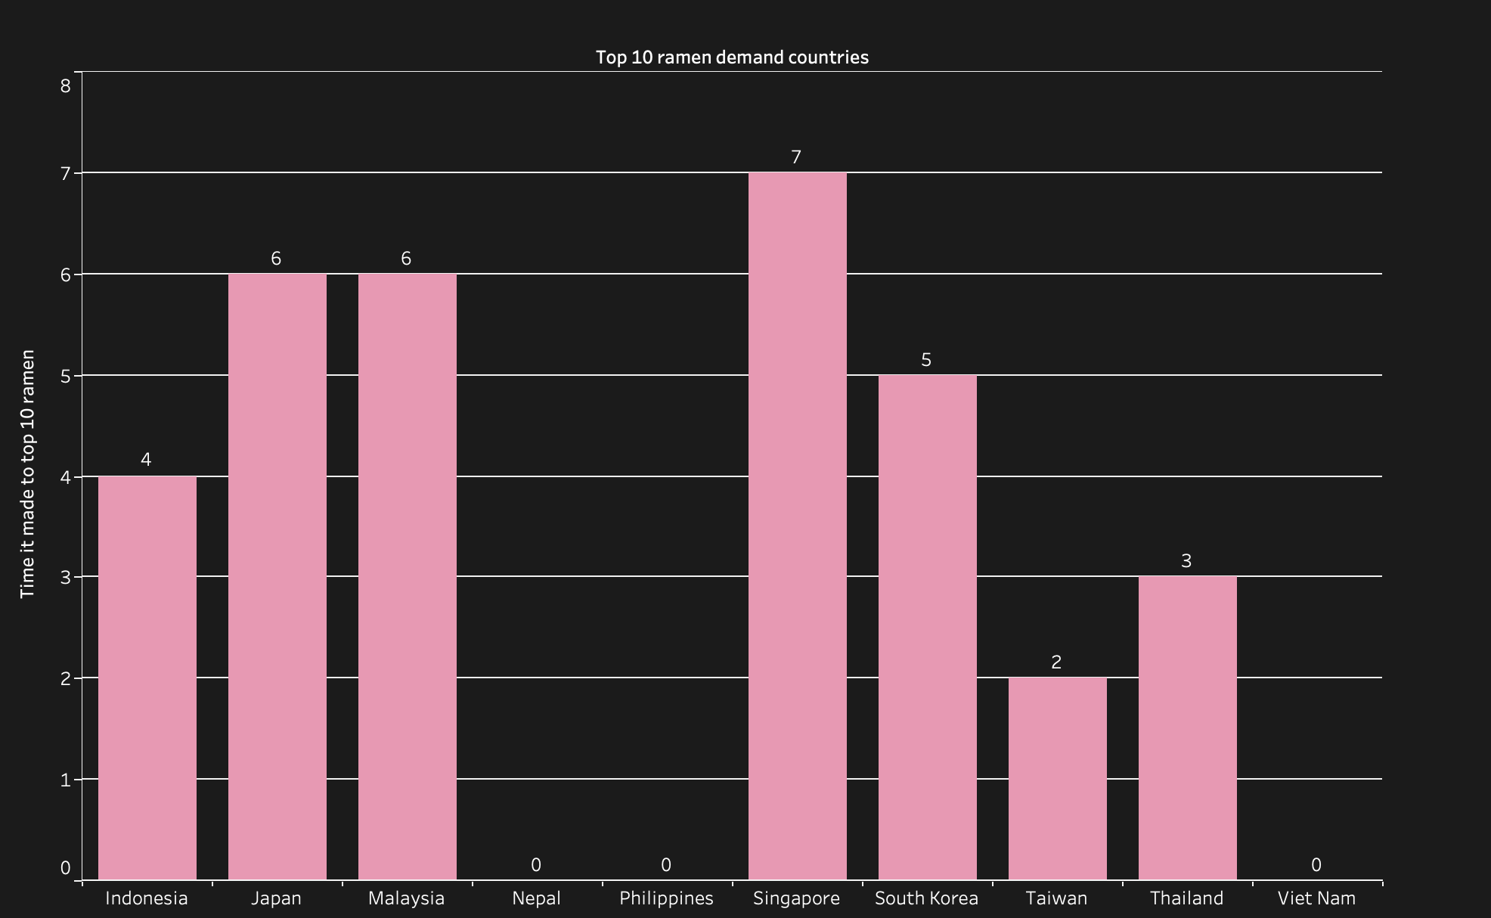
Ramen demand & Ramen making
Singapore, Japan and Malaysia made to top 10 ramen most frequently
Nepal, Philippines, and Viet Nam never made to top 10 ramen
Notes:
Singapore made to top 10 ramen most frequently for 7 times
Nepal, Philippines, and Viet Nam never made to top 10 ramen

Slide 25
Conclusion
Ramen demand is increasing every year due to its convenience and cheap price
Different countries prefer different flavors of ramen
Nissin is the world’s favorite brand of ramen
Countries with high demand for ramen also produce better ramen

Slide 26
Thank You

